Slide 1
Becoming a High Reliability School

Slide 2
Self System
Metacognitive System
Cognitive System
Knowledge

Slide 3
Hierarchy of Goals
Connection to something greater than self
Self actualization
Esteem within a community
Belonging
Safety
Physiology

Slide 4
What are Leading Indicators?
“Important conditions that are known to be associated with improvement”–Foley et al., n.d., p. 2
Provide direction about areas which may need work

Slide 5
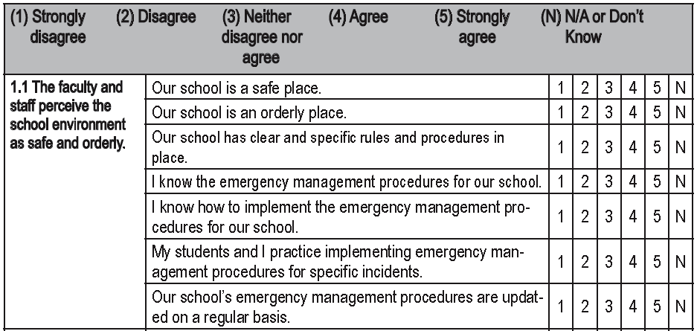
Surveys are used to measure initial perceptions of leading indicators
Example: Survey for one Level 1 leading indicator

Slide 6
How do we measure progress?
Lagging Indicators

Slide 7
What are Lagging Indicators?
Provide concrete evidence that a school has achieved a specific level of performance
Quantified by a criterion score
Note: Where leading indicators show what a school should work on to achieve high reliability status, lagging indicators are the evidence a school gives to validate its achievement of an HRS level.

Slide 8
How do we monitor, correct, and celebrate success?
Quick Data

Slide 9
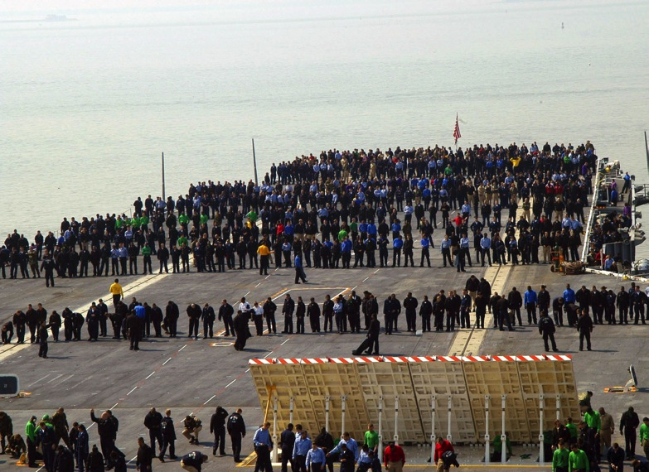
What are Quick Data?
Continuous monitoring using easily collected data
Examples:
FOD walks
Dieting

Slide 10
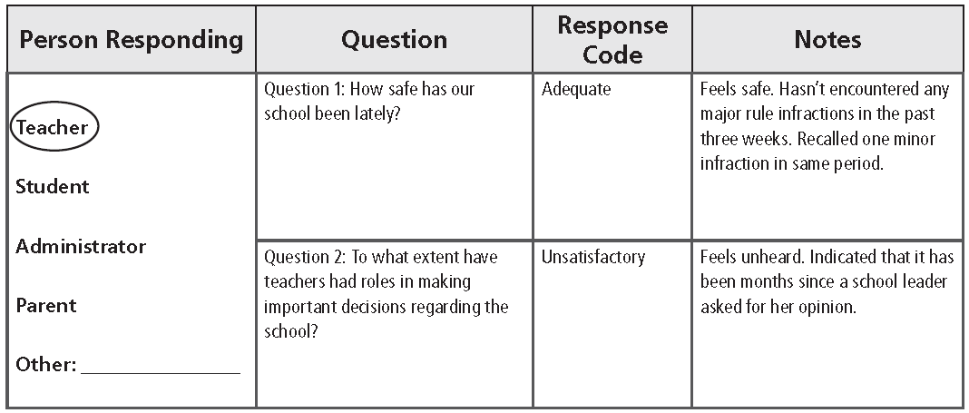
Quick Conversations
Responses are coded as excellent, adequate, or unsatisfactory
Notes capture anecdotal data

Slide 11
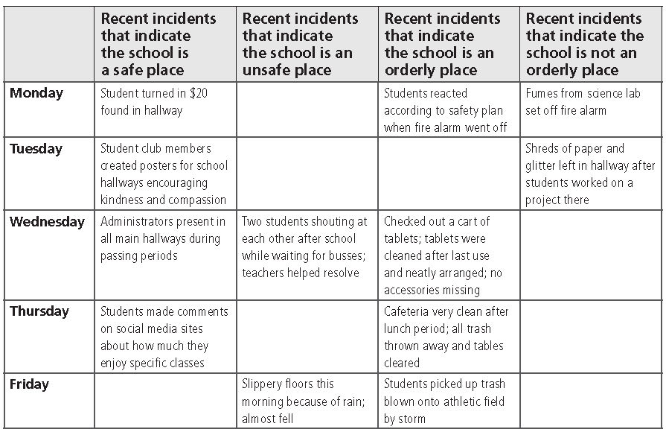
Quick Observations

Slide 12
Easy-to-Collect Quantitative Data
Examples:
Level 1 | Level 2 | Level 3 | Level 4 | Level 5
Rule violations Detentions Tardies Attendance data Expulsions Bullying incidents Truancies | Teacher scores on observation protocols Instructional rounds data Walk-through data Teacher PD requests | Curriculum alignment documents Student IEPs and ILPs Formative assessment data | Student and class progress tracking sheets Summative assessment data Student self-assessment reports | Scheduling documents Reports of college credits earned Student mastery reports Student growth reports

Slide 13
Moving Through the Levels
Level 5 | Competency-Based Education
Level 4 | Standards-Referenced Reporting
Level 3 | Guaranteed and Viable Curriculum
Level 2 | Effective Teaching in Every Classroom
Level 1 | Safe and Collaborative Culture

Slide 14
Leading Indicators for Level 1 Safe and Collaborative Culture
1.1 The faculty and staff perceive the school environment as safe and orderly.
1.2 Students, parents, and the community perceive the school environment as safe and orderly.
1.3 Teachers have formal roles in the decision-making process regarding school initiatives.
1.4 Teacher teams and collaborative groups regularly interact to address common issues regarding curriculum, assessment, instruction, and the achievement of all students.
1.5 Teachers and staff have formal ways to provide input regarding the optimal functioning of the school.
1.6 Students, parents, and the community have formal ways to provide input regarding the optimal functioning of the school.
1.7 The success of the whole school, as well as individuals within the school, is appropriately acknowledged.
1.8 The fiscal, operational, and technological resources of the school are managed in a way that directly supports teachers.

Slide 15
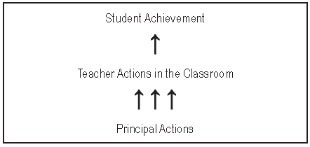
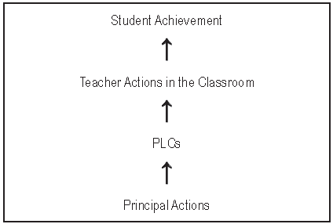
Level 1 Critical Commitment Safe and Collaborative Culture
Professional Learning Communities (PLC) Process

Slide 16
Level 1 Critical Commitment Safe and Collaborative Culture
Systematic Examples of Inspiration and Altruism

Slide 17
Moving Through the Levels
Level 5 | Competency-Based Education
Level 4 | Standards-Referenced Reporting
Level 3 | Guaranteed and Viable Curriculum
Level 2 | Effective Teaching in Every Classroom
Level 1 | Safe and Collaborative Culture

Slide 18
Leading Indicators for Level 2 Effective Teaching in Every Classroom
2.1 The school leader communicates a clear vision as to how instruction should be addressed in the school.
2.2 Support is provided to teachers to continually enhance their pedagogical skills through reflection and professional growth plans.
2.3 Predominant instructional practices throughout the school are known and monitored.
2.4 Teachers are provided with clear, ongoing evaluations of their pedagogical strengths and weaknesses that are based on multiple sources of data and are consistent with student achievement data.
2.5 Teachers are provided with job-embedded professional development that is directly related to their instructional growth goals.
2.6 Teachers have opportunities to observe and discuss effective teaching.

Slide 19
Use a scale that is designed to track growth

Slide 20
Innovating 4 | Applying 3 | Developing 2 | Beginning 1 | Not Using 0
New strategies are created to meet needs of specific students or class as a whole. | Strategy is used and monitored to see if it has desired effect. | Strategy is used but in a mechanistic way. | Strategy is used but pieces are missing. | Strategy is called for, but not used.

Slide 21
Innovating 4 | Applying 3 | Developing 2 | Beginning 1 | Not Using 0
New strategies are created to meet needs of specific students or class as a whole. | Strategy is used and monitored to see if it has desired effect. | Strategy is used but in a mechanistic way. | Strategy is used but pieces are missing. | Strategy is called for, but not used.

Slide 22
Moving Through the Levels
Level 5 | Competency-Based Education
Level 4 | Standards-Referenced Reporting
Level 3 | Guaranteed and Viable Curriculum
Level 2 | Effective Teaching in Every Classroom
Level 1 | Safe and Collaborative Culture

Slide 23
Leading Indicators for Level 3 Guaranteed and Viable Curriculum
3.1 The school curriculum and accompanying assessments adhere to state and district standards.
3.2 The school curriculum is focused enough that it can be adequately addressed in the time available to teachers.
3.3 All students have the opportunity to learn the critical content of the curriculum.
3.4 Clear and measureable goals are established and focused on critical needs regarding improving overall student achievement at the school level.
3.5 Data are analyzed, interpreted, and used to regularly monitor progress toward school achievement goals.
3.6 Appropriate school- and classroom-level programs and practices are in place to help students meet individual achievement goals when data indicate interventions are needed.

Slide 24
Level 3 Critical Commitment Guaranteed and Viable Curriculum
Guaranteed and viable curriculum (GVC)
Guaranteed: the content that should be addressed at each grade level in each subject area is clearly defined
Viable: the content can be adequately addressed in the instructional time available

Slide 25
Critical Aspects Guaranteed and Viable Curriculum
Continually monitoring the viability of the curriculum
A comprehensive vocabulary program
Direct instruction in knowledge application and metacognitive skills

Slide 26
Vocabulary Terms & Phrases
Classroom Practice:
Identify critical terms and phrases
Use a research-based process for teaching new terms and phrases

Slide 27
Isabelle Beck’s Distinctions
Tier 1 words
Tier 2 words
Tier 3 words

Slide 28
We now know the playing field.
Category | N of Words
Tier 1: Basic (General Vocab) | 2,845
Tier 2: Advanced (General Vocab) | 5,162
Tier 3: Academic (All Subjects) | 7,923
Total | 15,930 (15,000 without repeats)

Slide 29
There is no longer an excuse for any student to leave school lacking a general knowledge of... the basic general terms, the advanced general terms, and the academic terms… necessary for success in society.

Slide 30
3rd Grade Mathematics
angle area average bar graph congruent difference estimation hexagon length width | octagon parallel perimeter product rhombus square symmetry triangle vertical horizontal

Slide 31
3rd Grade Science
predict compare observe investigate analyze amplify frequency vibration Newton properties | pitch food web life cycle living organism structure inherit reproduction environment characteristics hypothesis

Slide 32
3rd Language Arts
actor animation audience cause & effect commercial conclusion cue detail directions drama | ending facial expression humor minor character main character plot development role playing central idea mood myth

Slide 33
3rd Social Studies
prairie Oregon Trail lariat oxen expedition territory homestead settlement pioneer farm/ranch | Native American legacy stampede fertile wagon trails cabin cattle seasonal dwelling plateau frontier

Slide 34
Sample Cognitive Skills
Cognitive Skill | Description
Generating conclusions | Involves combining pieces of known information to form new ideas.
Identifying common logical errors | Involves analyzing information to determine how true it is.
Presenting and supporting claims | Involves expressing a new idea and presenting information to support it.
Navigating digital sources | Involves using electronic resources to find credible and relevant information.
Problem solving | Involves accomplishing a goal in spite of obstacles or limiting conditions.
Decision making | Involves using criteria to select among alternatives that initially appear to be equal.
Experimenting | Involves generating and testing explanations of observed phenomena.
Investigating | Involves identifying confusions or contradictions about ideas or events and suggesting ways to resolve those confusions or contradictions.
Identifying basic relationships between ideas | Involves consciously analyzing relationships between ideas to better understand complex texts.
Generating and manipulating mental images | Involves creating images in one’s mind to facilitate deep processing and memory of information.

Slide 35
Reasoning Processes That Relate to College and Career Readiness
Cognitive Skills | Conative Skills
Generating conclusions Identifying common logical errors Presenting and supporting claims Navigating digital sources Problem solving Decision making Experimenting Investigating Identifying basic relationships between ideas Generating and manipulating mental images | Becoming aware of the power of interpretations Cultivating a growth mindset Cultivating resiliency Avoiding negative thinking Taking various perspectives Interacting responsibly Handling controversy and conflict resolution

Slide 36
Moving Through the Levels
Level 5 | Competency-Based Education
Level 4 | Standards-Referenced Reporting
Level 3 | Guaranteed and Viable Curriculum
Level 2 | Effective Teaching in Every Classroom
Level 1 | Safe and Collaborative Culture

Slide 37
Leading Indicators for Level 4 Standards-Referenced Reporting
4.1 Clear and measureable goals are established and focused on critical needs regarding improving achievement of individual students within the school.
4.2 Data are analyzed, interpreted, and used to regularly monitor progress toward achievement goals for individual students.

Slide 38
Level 4 Critical Commitment Standards-Referenced Reporting
Clearly communicate what students know and how much they have learned at school

Slide 39
Example Proficiency Scale
Insert learning goals into the proficiency scale

Slide 40
Topic Grade 8: Atmospheric Processes and Water Cycle
4
3 | An understanding of: How the water cycle processes (condensation, precipitation, surface run-off, percolation, evaporation) impact climate changes The effects of temperature and pressure in different layers of Earth’s atmosphere
2
1
0

Slide 41
Topic Grade 8: Atmospheric Processes and Water Cycle
4
3 | An understanding of: How the water cycle processes (condensation, precipitation, surface run-off, percolation, evaporation) impact climate changes The effects of temperature and pressure in different layers of Earth’s atmosphere
2 | Recognize and recall basic terms: climatic patterns, atmospheric layers, stratosphere, troposphere. Recognize or recall isolated details such as: Precipitation is one of the processes of the water cycle. The troposphere is one of the lowest portions of the Earth’s atmosphere.
1
0

Slide 42
Topic Grade 8: Atmospheric Processes and Water Cycle
4 | Infer relationships regarding atmospheric processes and the water cycle.
3 | An understanding of: How the water cycle processes (condensation, precipitation, surface run-off, percolation, evaporation) impact climate changes The effects of temperature and pressure in different layers of Earth’s atmosphere
2 | Recognize and recall basic terms such as: climatic patterns, atmospheric layers, stratosphere, troposphere. Recognize or recall isolated details such as: Precipitation is one of the processes of the water cycle. The troposphere is one of the lowest portions of the Earth’s atmosphere.
1
0

Slide 43
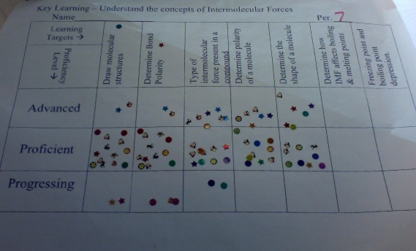
Erik, AP Chemistry, ThunderRidge HS, DCSD

Slide 44
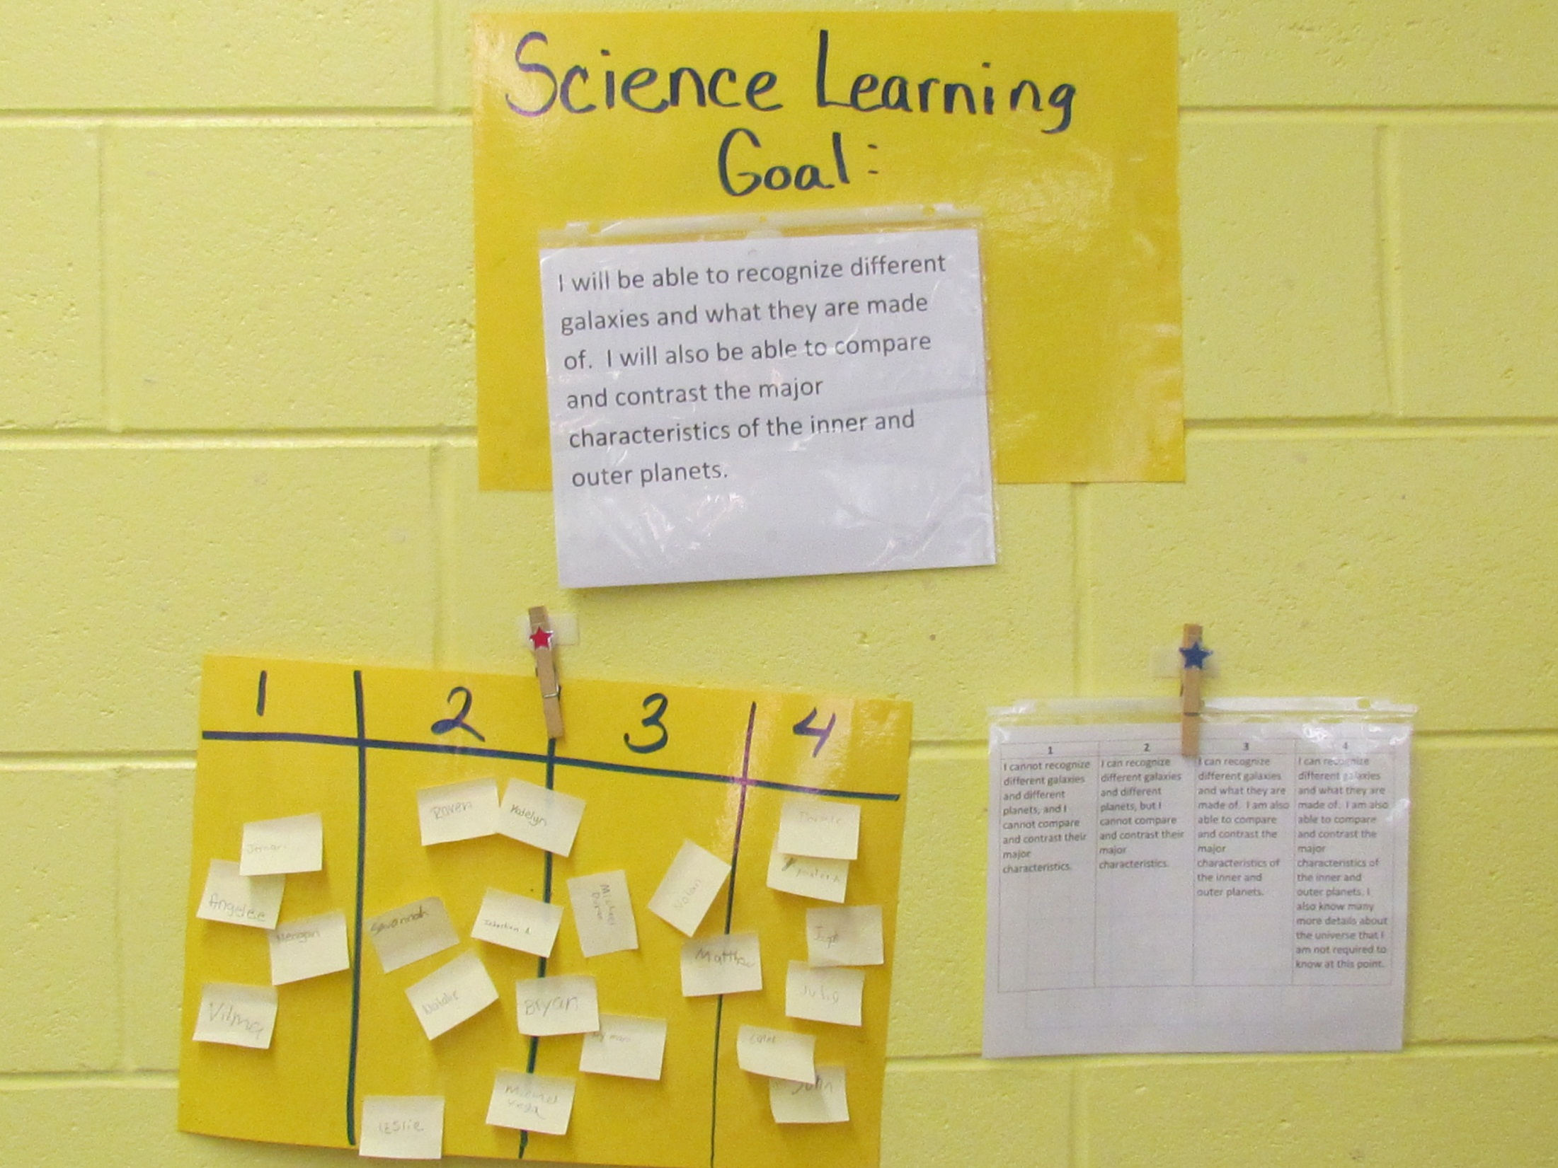

Slide 45
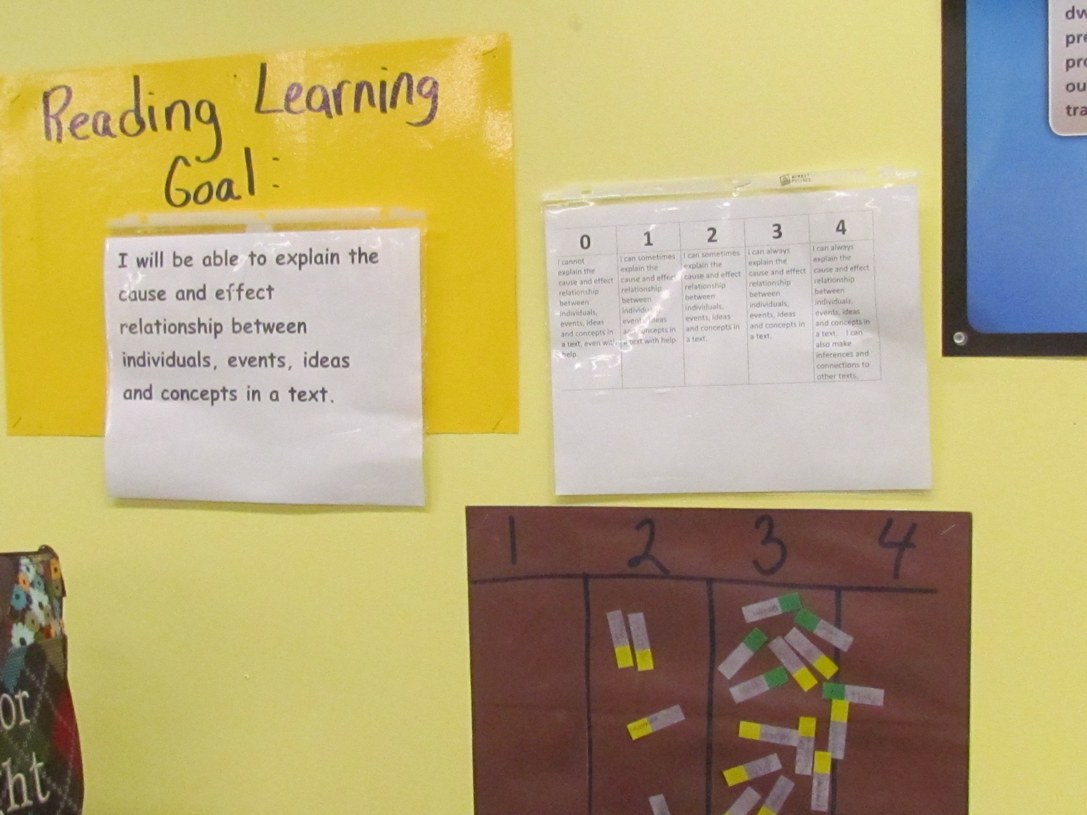

Slide 46
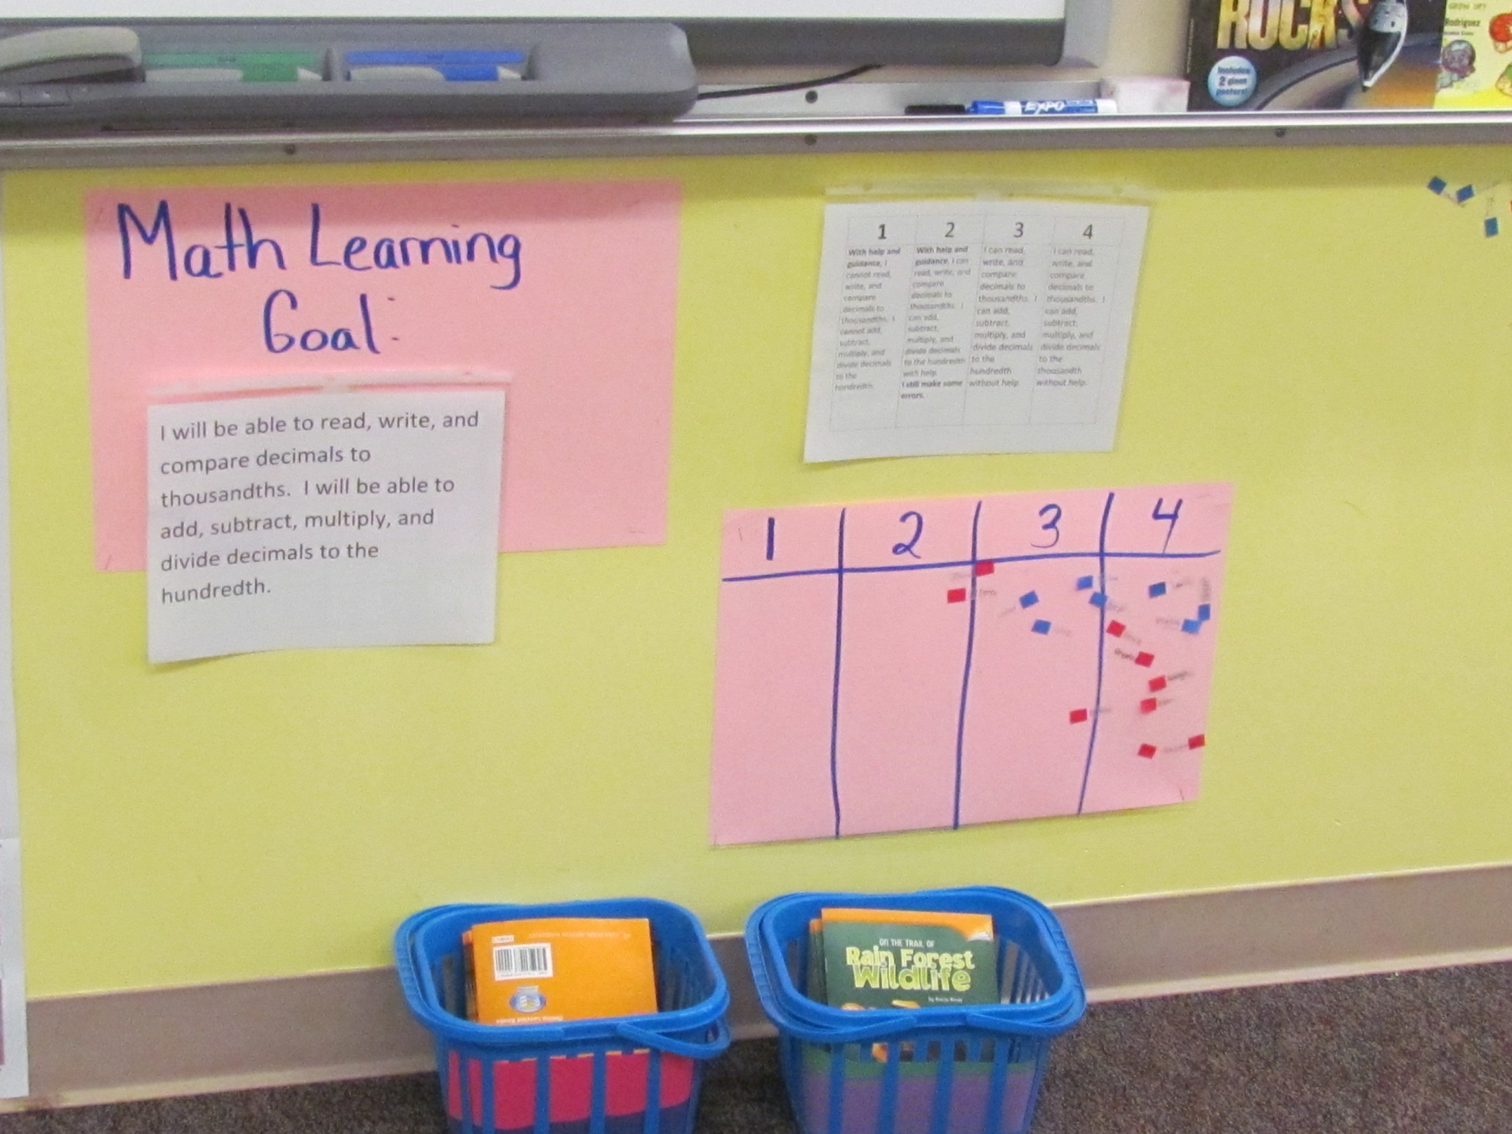

Slide 47
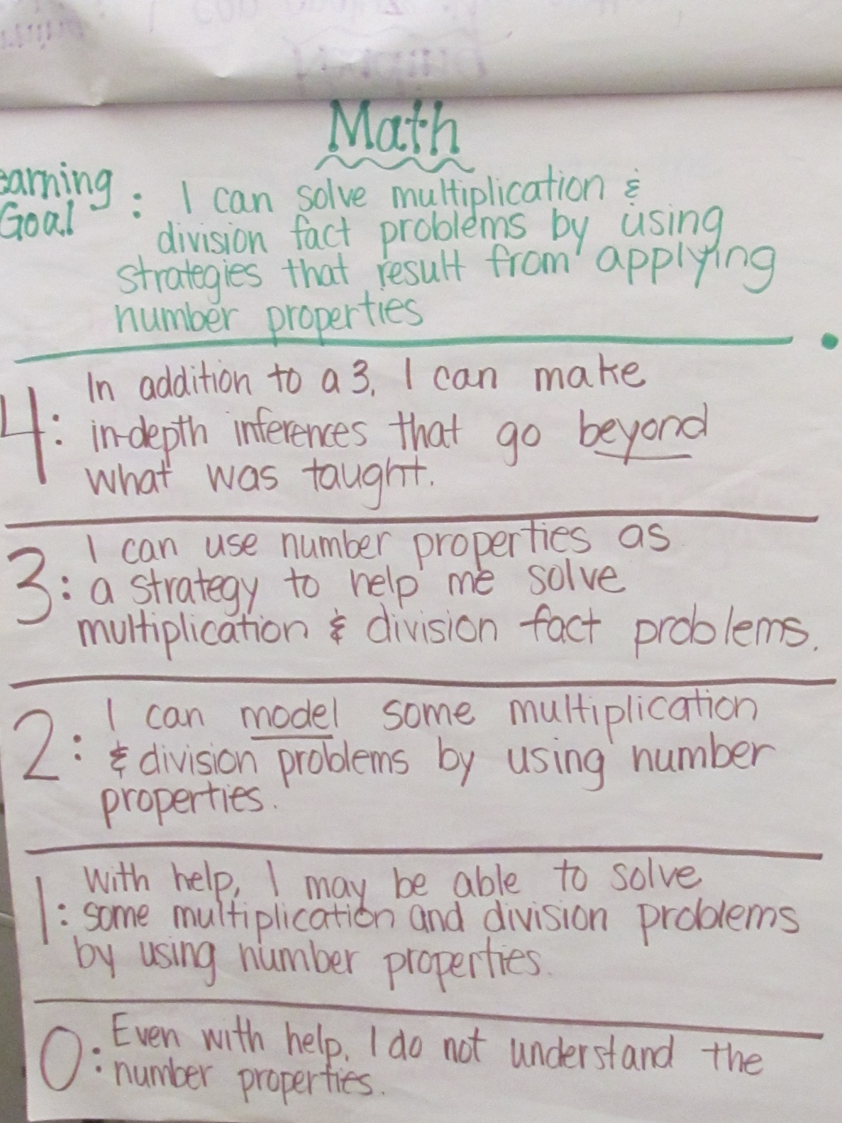

Slide 48
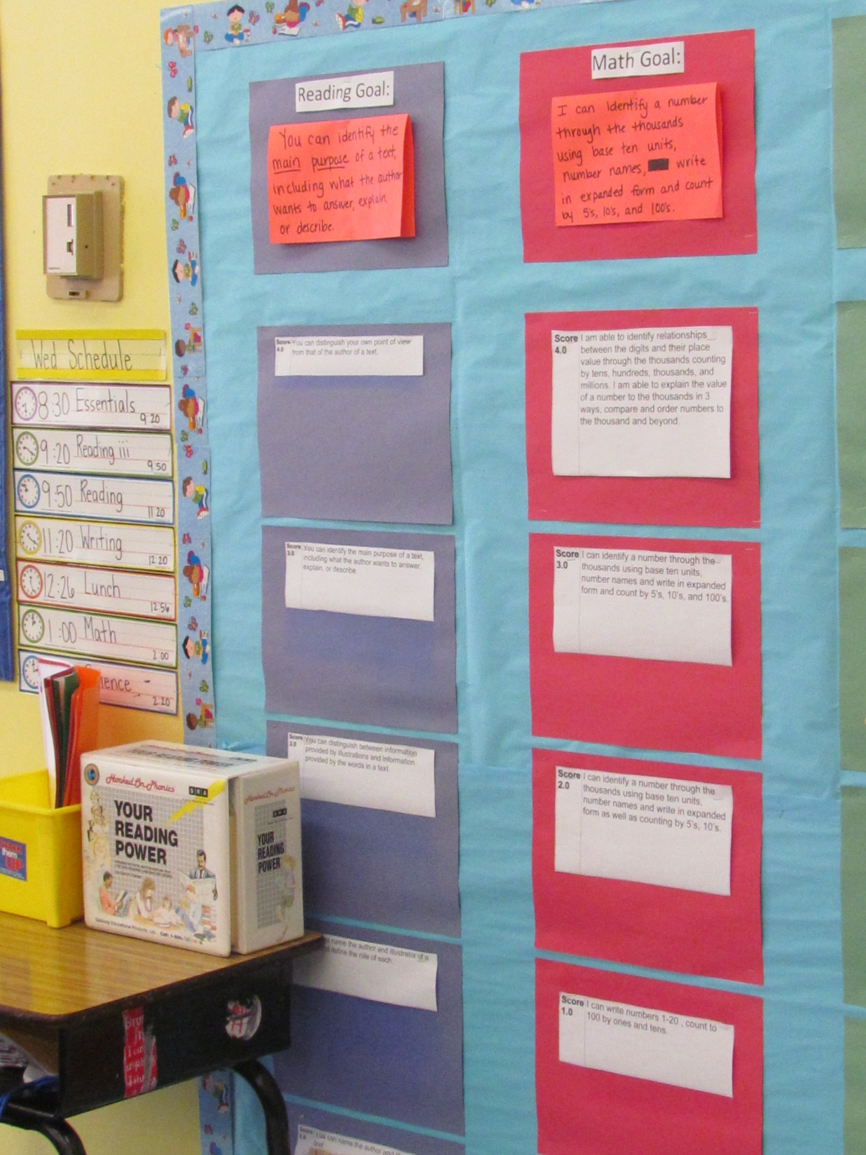

Slide 49
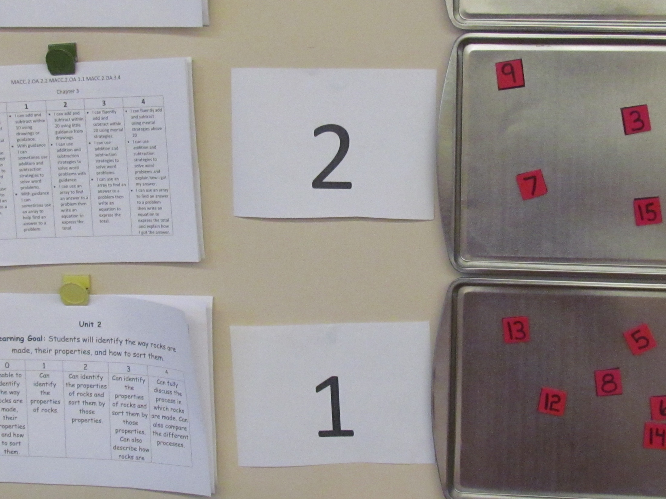

Slide 50
Power Law
Observed
Score
1
1
1.5
1.5
2
1.5
3
3
2.5
2.21
Learning Trend = 2.21
2
2.08
1.94
Average Score = 1.64
1.78
1.5
1.55
Mode = 1.5
1.24
1
.5
.71
0
Pretest Score 2 Score 3 Score 4 Score 5 Score 6 Post-Test

Slide 51
Students track their progress the entire year.

Slide 52
 | .00 | .5 | 1.0 | 1.5 | 2.0 | 2.5 | 3.0 | 3.5 | 4.0
T1
T2
T3
T4
T5
T6
T7
T8
T9
T10
T11
T12
T13
T14
T15
T16
T17
T18
T19
T20
T21
T22
T23
T24

Slide 53
 | .00 | .5 | 1.0 | 1.5 | 2.0 | 2.5 | 3.0 | 3.5 | 4.0
T1
T2
T3
T4
T5
T6
T7
T8
T9
T10
T11
T12
T13
T14
T15
T16
T17
T18
T19
T20
T21
T22
T23
T24

Slide 54
 | .00 | .5 | 1.0 | 1.5 | 2.0 | 2.5 | 3.0 | 3.5 | 4.0
T1
T2
T3
T4
T5
T6
T7
T8
T9
T10
T11
T12
T13
T14
T15
T16
T17
T18
T19
T20
T21
T22
T23
T24

Slide 55
 | .00 | .5 | 1.0 | 1.5 | 2.0 | 2.5 | 3.0 | 3.5 | 4.0
T1
T2
T3
T4
T5
T6
T7
T8
T9
T10
T11
T12
T13
T14
T15
T16
T17
T18
T19
T20
T21
T22
T23
T24

Slide 56
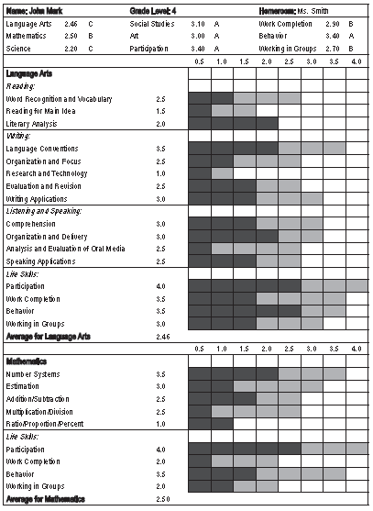
Critical Aspect Standards-Referenced Reporting
Report status and growth on the report card using proficiency scales

Slide 57
3.00 – 4.00 = A
2.50 – 2.99 = B
2.00 – 2.49 = C
1.50 – 1.99 = D
Below 1.50 = F

Slide 58
Conversion to %
4.0 = 100%
3.5 = 95%
3.0 = 90%
2.5 = 80%
2.0 = 70%
1.5 = 65%
1.0 = 60%
Below 1.0 = 50%

Slide 59
Moving Through the Levels
Level 5 | Competency-Based Education
Level 4 | Standards-Referenced Reporting
Level 3 | Guaranteed and Viable Curriculum
Level 2 | Effective Teaching in Every Classroom
Level 1 | Safe and Collaborative Culture

Slide 60
Leading Indicators for Level 5 Competency-Based Education
5.1 Students move on to the next level of the curriculum for any subject area only after they have demonstrated competence at the previous level.
5.2 The school schedule is designed to accommodate students moving at a pace appropriate to their background and needs.
5.3 Students who have demonstrated competency levels greater than those articulated in the system are afforded immediate opportunities to begin work on advanced content and/or career paths of interest.

Slide 61
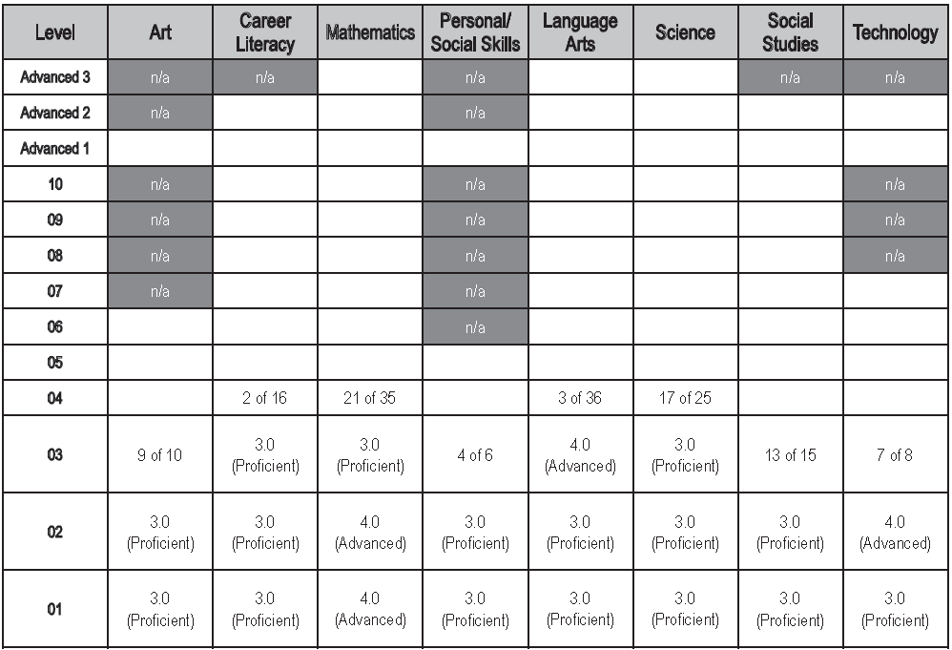
Critical Aspect Competency-Based Education
Adjusting reporting systems accordingly

Slide 62
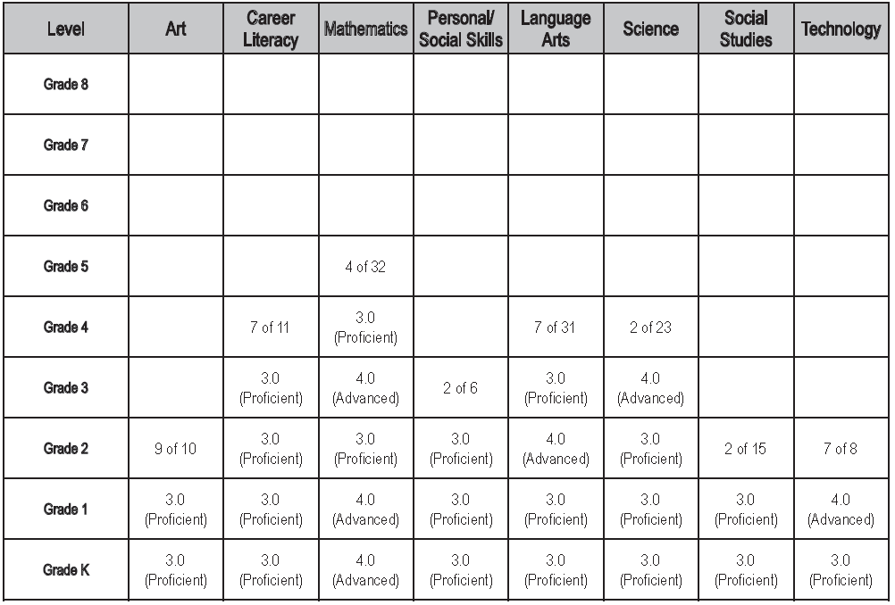
Reporting System: Grade-Level Approach

Slide 63
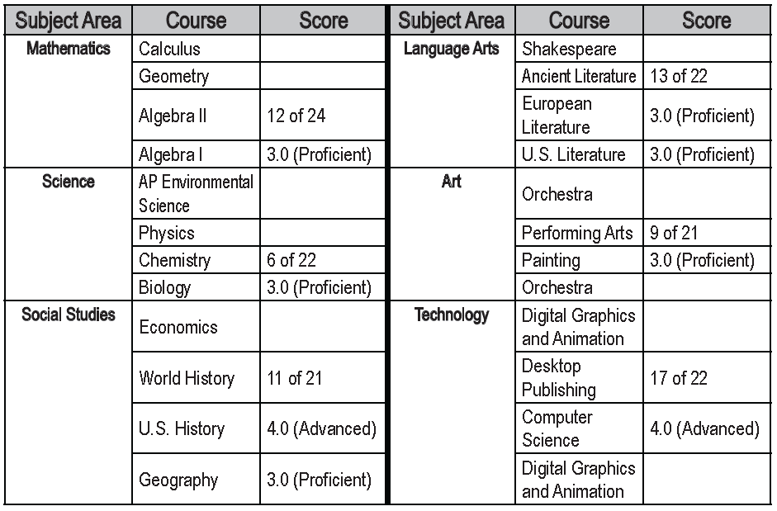
Reporting System: High School Approach

Slide 64
Competency-Based Feedback, Teaching, and Reporting

Slide 65
Foundational Shift: From one big score to a bunch of little scores

Slide 66
Decision Points

Slide 67
How Topics Are Articulated and Assessed
Broad topics assessed using traditional measures only
Topics articulated as proficiency scales (i.e. learning progressions) and assessed using multiple forms of assessment

Slide 68
How Topics Are Articulated and Assessed
Broad topics assessed using traditional measures only
Topics articulated as proficiency scales (i.e. learning progressions) and assessed using multiple forms of assessment

Slide 69
Unpacking Standards

Slide 70
Current Standards Statements
Use the volumes of cones, spheres, and cylinders to solve real-world and mathematical problems
Use informal arguments to establish facts about the sum and exterior angles of triangles, about the angles created when parallel lines are cut by a transversal, and about the angle-angle criterion for similarity of triangles

Slide 71
Measurement Topic Statements
Explain how to evaluate a base raised to an integer exponent (for example, explain why 3³ = 27 and 3⁻³ = 1/27)
Explain how to evaluate exponential expressions involving the same base raised to integer exponents (fore example, explain why 3² x 3⁻⁵ = 3⁻³ and (4²) ³ = 4⁶).

Slide 72
Measurement Topics: Grade 8 Math
The concept of functions
Bivariate data
Proportional relationships
Rate of change
Slope and intercept
Similarity, congruence, transformations
Angles
Systems of linear equations
Expressions
Quadratic equations
Cubes and squares
Exponents
Scientific notation
Irrational numbers
Scatterplots and data association
Pythagorean theorem
Volume
Lines
Measurement
Properties of shapes
Area and perimeter
Distributions
Probability

Slide 73
Cizek (2007)
State test for a large Midwestern state: reliability = .87
Subscales: Estimation and mental computation, geometry, measurement, number and number relations, patterns, algebra, problem solving
Subscale reliabilities = .33 to .57

Slide 74
Cizek (2007)
State test for a large Midwestern state: reliability = .87
Subscales: Estimation and mental computation, geometry, measurement, number and number relations, patterns, algebra, problem solving
Subscale reliabilities = .33 to .57
Reliability of differences scores = .015

Slide 75
It might be that the dependability of conclusions about differences in sub-area performance is nearly zero. In many cases, a teacher who flipped a coin to decide whether to provide the pupil with focused intervention in algebra (heads) or measurement (tails) would be making the decision about as accurately as the teacher who relied on an examination of sub-score differences for the two areas.

Slide 76
Observed score = true score + error

Slide 77
250 Studies With Classroom Assessments: SD = 12 points Reliability = .45
Rel = .45 | 70 | 52 | 88
Rel = .55 | 70 | 54 | 86
Rel = .65 | 70 | 56 | 84
Rel = .75 | 70 | 58 | 82

Slide 78
How Topics Are Articulated and Assessed
Broad topics assessed using traditional measures only
Topics articulated as proficiency scales (i.e. learning progressions within a level) and assessed using multiple forms of assessment

Slide 79
At a very basic level, a proficiency scale is nothing more than thinking about the content for an important topic in terms of three levels of difficulty.

Slide 80
4 | More complex learning goal
3 | Target learning goal
2 | Simpler learning goal

Slide 81
Topic: Atmospheric Processes and Water Cycle
4
3 | An understanding of: How the water cycle processes (condensation, precipitation, surface run-off, percolation, evaporation) impact climate changes The effects of temperature and pressure in different layers of Earth’s atmosphere
2
1
0

Slide 82
4 | More complex learning goal
3 | Target learning goal
2 | Simpler learning goal

Slide 83
Topic: Atmospheric Processes and Water Cycle
4
3 | An understanding of: How the water cycle processes (condensation, precipitation, surface run-off, percolation, evaporation) impact climate changes The effects of temperature and pressure in different layers of Earth’s atmosphere
2 | Recognize and recall basic terms: climatic patterns, atmospheric layers, stratosphere, troposphere. Recognize or recall isolated details such as: Precipitation is one of the processes of the water cycle. The troposphere is one of the lowest portions of the Earth’s atmosphere.
1
0

Slide 84
4 | More complex learning goal
3 | Target learning goal
2 | Simpler learning goal

Slide 85
Topic: Atmospheric Processes and Water Cycle
4 | Describe and defend what might occur to climatic patterns in a specific location given a dramatic change in one specific process of the water cycle.
3 | An understanding of: How the water cycle processes (condensation, precipitation, surface run-off, percolation, evaporation) impact climate changes The effects of temperature and pressure in different layers of Earth’s atmosphere
2 | Recognize and recall basic terms such as: climatic patterns, atmospheric layers, stratosphere, troposphere. Recognize or recall isolated details such as: Precipitation is one of the processes of the water cycle. The troposphere is one of the lowest portions of the Earth’s atmosphere.
1
0

Slide 86
4 | More complex learning goal
3 | Target learning goal
2 | Simpler learning goal
1 | Demonstration of partial competence with help
0 | Even with help no demonstrated competence

Slide 87
Daily targets can be expressed as “I can” statements and posted as separate items while they are the subject of instruction.

Slide 88
Topic: Atmospheric Processes and Water Cycle
4 | Describe and defend what might occur to climatic patterns in a specific location given a dramatic change in one specific process of the water cycle.
3 | An understanding of: How the water cycle processes (condensation, precipitation, surface run-off, percolation, evaporation) impact climate changes The effects of temperature and pressure in different layers of Earth’s atmosphere
2 | Recognize and recall basic terms such as: climatic patterns, atmospheric layers, stratosphere, troposphere. Recognize or recall isolated details such as: Precipitation is one of the processes of the water cycle. The troposphere is one of the lowest portions of the Earth’s atmosphere.
1
0

Slide 89
I can describe the characteristics of the troposphere and explain how it fits into the earth’s atmosphere

Slide 90
Erik, AP Chemistry, ThunderRidge HS, DCSD

Slide 94
Reporting

Slide 95
Example Proficiency Scale

Slide 96
Critical Aspect Standards-Referenced Reporting
Report status and growth on the report card using proficiency scales

Slide 97
3.00 – 4.00 = A
2.50 – 2.99 = B
2.00 – 2.49 = C
1.50 – 1.99 = D
Below 1.50 = F

Slide 98
3.25 – 4.00 = A
2.75 – 3.24 = B
2.00 – 2.74 = C
1.50 – 1.99 = D
Below 1.50 = F

Slide 99
Conversion to %
4.0 = 100%
3.5 = 92%
3.0 = 84%
2.5 = 76%
2.0 = 68%
1.5 = 60%
1.0 = 52%
0.5 = 44%
0.0 = 00%

Slide 100
Conversion to %
4.0 = 100%
3.5 = 95%
3.0 = 90%
2.5 = 80%
2.0 = 70%
1.5 = 65%
1.0 = 60%
Below 1.0 = 50%

Slide 101
 | .00 | .5 | 1.0 | 1.5 | 2.0 | 2.5 | 3.0 | 3.5 | 4.0
T1
T2
T3
T4
T5
T6
T7
T8
T9
T10
T11
T12
T13
T14
T15
T16
T17
T18
T19
T20
T21
T22
T23
T24

Slide 102
 | .00 | .5 | 1.0 | 1.5 | 2.0 | 2.5 | 3.0 | 3.5 | 4.0
T1
T2
T3
T4
T5
T6
T7
T8
T9
T10
T11
T12
T13
T14
T15
T16
T17
T18
T19
T20
T21
T22
T23
T24

Slide 103
 | .00 | .5 | 1.0 | 1.5 | 2.0 | 2.5 | 3.0 | 3.5 | 4.0
T1
T2
T3
T4
T5
T6
T7
T8
T9
T10
T11
T12
T13
T14
T15
T16
T17
T18
T19
T20
T21
T22
T23
T24

Slide 104
 | .00 | .5 | 1.0 | 1.5 | 2.0 | 2.5 | 3.0 | 3.5 | 4.0
T1
T2
T3
T4
T5
T6
T7
T8
T9
T10
T11
T12
T13
T14
T15
T16
T17
T18
T19
T20
T21
T22
T23
T24

Slide 105
Topic: Atmospheric Processes and Water Cycle
4 | Describe and defend what might occur to climatic patterns in a specific location given a dramatic change in one specific process of the water cycle. | Instructions and web-based resources and activities that allow students to address this content independently
3 | An understanding of: How the water cycle processes (condensation, precipitation, surface run-off, percolation, evaporation) impact climate changes The effects of temperature and pressure in different layers of Earth’s atmosphere | Instructions and web-based resources and activities that allow students to address this content independently
2 | Recognize and recall basic terms such as: climatic patterns, atmospheric layers, stratosphere, troposphere. Recognize or recall isolated details such as: Precipitation is one of the processes of the water cycle. The troposphere is one of the lowest portions of the Earth’s atmosphere. | Instructions and web-based resources and activities that allow students to address this content independently
1
0

Slide 106
Topic: Atmospheric Processes and Water Cycle
4 | Describe and defend what might occur to climatic patterns in a specific location given a dramatic change in one specific process of the water cycle. | Directions for specific requirements regarding what topics must be addressed On-line resources students might use Examples from previous students
3 | An understanding of: How the water cycle processes (condensation, precipitation, surface run-off, percolation, evaporation) impact climate changes The effects of temperature and pressure in different layers of Earth’s atmosphere | Khan Academy video Teacher created screen casts Pages in a book Practice sheets Shorts formative assessments
2 | Recognize and recall basic terms such as: climatic patterns, atmospheric layers, stratosphere, troposphere. Recognize or recall isolated details such as: Precipitation is one of the processes of the water cycle. The troposphere is one of the lowest portions of the Earth’s atmosphere. | Khan Academy video Teacher created screen casts Pages in a book Practice sheets Shorts formative assessments
1
0

Slide 107
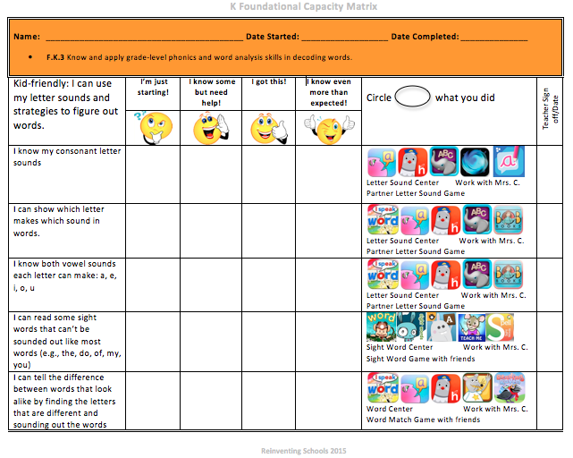

Slide 108
Personalized Learning
Multiple pathways to learning the content
Multiple options to demonstrate competence

